Slide 1

35th International Physics Olympiad
Pohang, Korea
15 ~ 23 July 2004
Theoretical Question 3
Theoretical Competition
Saturday, 17 July 2004

Slide 2
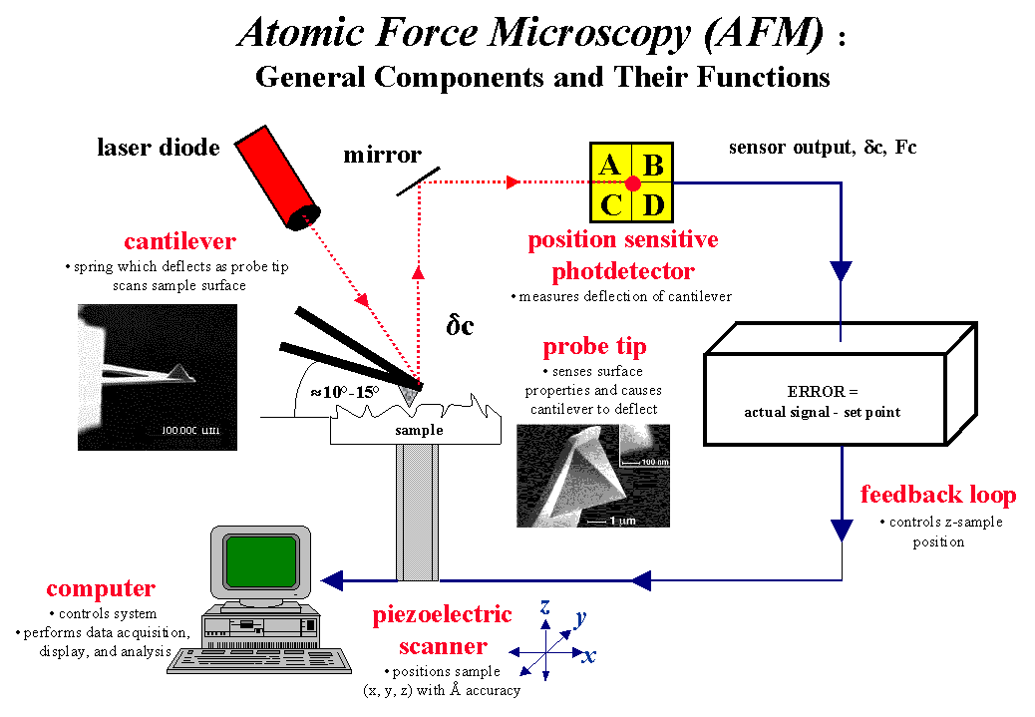
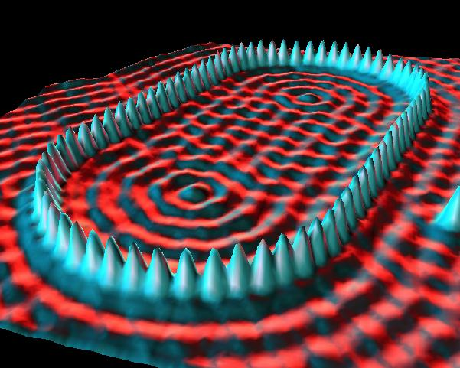
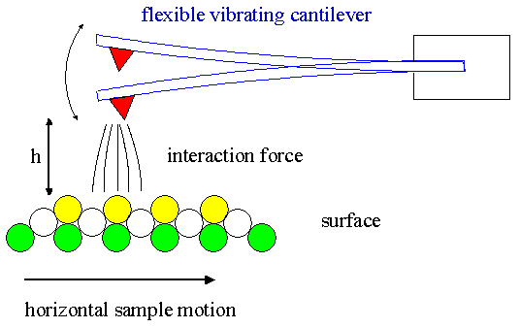
Theoretical Question 3:
“Scanning Probe Microscope”
Objective: To locate a single electron under the surface

Slide 3
Theoretical Question 3:
“Scanning Probe Microscope”
Problem design:
Harmonic Waves
V_{i}=c₂z
photo-detector
output signal
lock-in
amplifier
input
ref.
laser
V_{i}
V_{R}
Hooke’s Law
phase shifter
k
piezotube
F
z=0
m
piezotube
F
Cantilever
k
sample
m
Coulomb’s Law
Harmonic
Oscillator

Slide 4
Theoretical Question 3:
“Scanning Probe Microscope”
Physical concepts required:
  Oscillations
    Harmonic Oscillations
    Harmonic Waves
    Resonance
  Electricity
    Coulomb’s Law
  Mechanics
    Hooke’s Law
    Force Equilibrium

